Slide 1
Introduction Database checkpoint

Slide 2
MySQL
*offers limited functionality for temporary tables ,Developers cannot set variables or create global templates. The software even limits the number of times that a temporary table can be referred to – not more than once.
* organized indexes in tables and clusters. Developers can automatically locate and update indexes in their databases. The search isn’t highly flexible – you can’t search for multiple indexes in a single query. MySQL supports multi-column indexes, allowing adding up to 16 columns.

Slide 3
Postgresql
* offers a lot more functionality when it comes to temporary content. You divide temporary tables into local and global and configure them with flexible variables.
*supports index-based table organization, but the early versions don’t include automated index updates (which appear only after the 11th edition release). The solution also allows looking up many indexes in a single search, which means that you can find a lot of information. The multi-column settings are also more flexible than in MySQL – developers can include up to 32 columns.

Slide 4
SQL Server
*offers rich functionality for temporary table management. You can create local and global temporary tables, as well as oversee and create variables.
*offers rich automated functionality for index management. They can organize in clusters and maintain the correct row order without manual involvement. The solution also supports multiple-index searches and partial indexes.

Slide 5
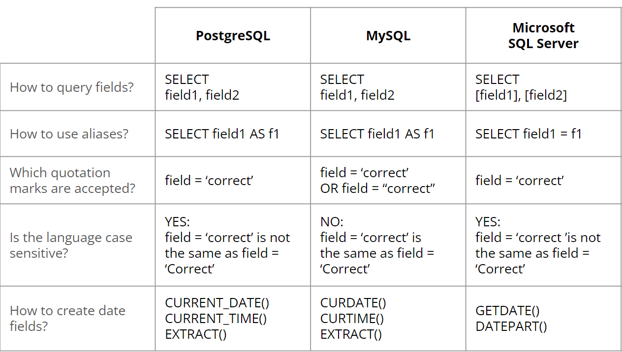
Comparison

